Slide 1


Big Data Seminar – BIA 678
David Belanger PhD
Senior Research Fellow – Stevens Institute of Technology
dbelange@stevens.edu
http://www.examiner.com/images/blog/EXID1827/images/shamrock.jpg

Slide 2
Class 14 – Analytics I– Outline Occam’s Razor “Everything Should Be As Simple As Possible, But Not Simpler” – Albert Einstein
Administrative Stuff:
Team Project Abstracts Submitted
Team Project Questions
Speaker: 4/30 Dr. Yifan Hu, Oath (Verizon) Research
Activity #1 – Check on Team Project Progress and/or Questions
Activity #2 – Questions on Recommenders or Ensembles
Activity #3 –Governance
Readings for This Week (First and One of Two Following):
https://www.isaca.org/chapters3/Atlanta/AboutOurChapter/Documents/GW2014/Implementing%20a%20Data%20Governance%20Program%20-%20Chalker%202014.pdf
Verizon Data Breach Digest 2017 (on CANVAS)
Class 12 - Are You Solving the Right Problems_ Harvard Business Review jan-feb 2017
Next Week:
https://www2.deloitte.com/content/dam/Deloitte/nl/Documents/risk/deloitte-nl-risk-gdpr-vision-approach.pdf - GDPR Vision and Approach Deloitte – Pg 1-9.
Shneiderman, Ben, Extreme Visualization: Squeezing a Billion Records into a Million Pixels http://www.cs.umd.edu/~ben/papers/Shneiderman2008Extreme.pdf

Slide 3
Formats for Team Project Reports
​No template - use the format that expresses your project the best, but in general there should be:
List of Speakers in Order of Appearance.
Introduction (including goals)
Data and Data Preparation
Analysis
Results
Performance Measurements
Conclusion
Report should be 5 - 10 pages (most will be closer to 10), double spaced with 12 point font. If there need to be displays of data or programs they should be in appendices (usually not necessary).

Slide 4
Formats for Team Project Talks
​No template - use the format that expresses your project the best, but in general there should be:
Introduction (including goals)
Data and Data Preparation
Analysis
Results
Performance Measurements
Conclusion
Talks should be about 5 minutes per individual (maybe 3 slides per person unless you are a practiced speaker).
Speak to the class, as opposed to only me, and look at them.
Can defer some things to report.

Slide 5
Grading for Team Projects (40%)
Last Name
First Name
Team #
Oral Presence
Oral Knowledge Displayed
Oral Clarity
Oral Content
Knowledge Displayed
Depth
Clarity
Content
Conclusion
Total

Slide 6

A More Complete Picture
Data
Management
Visualization
Applications
Data Analysis
Incubation
Data Governance – Policy, Process
Data Security
Sandbox
Privacy
Integrity
OA&M
Semantics
Software
Framing Questions
Sustainability
Distribution & Ownership
of Results

Slide 7
Data Governance
Policy => Process => Practice
Data Modeling
Data Quality
Risk & Compliance
Retention
Privacy and Security
Chief Data Officer or CIO? Chief Privacy Officer, Chief Security Officer, …

Slide 8
Data Governance
Policy => Process => Practice
Steps to Big Data Governance:
Set Objectives for use of data assets
New Revenue
Lower Costs
Compliance and Regulation
Reducing Risk
Define Governance from the start

Slide 9
Data Governance
Policy => Process => Practice
Steps to Big Data Governance:
Measure Performance and Conformance
Enforce Governance Rules
Know your data assets, and their characteristics
Create Procedures for Portable and Mobile Data Devices
Define training requirements

Slide 10
Data Governance Topics
Policy => Process => Practice
Steps to Big Data Governance:
Meta Issues:
Quality
Privacy
Security and DLP
Semantics and Classification
Conformance and Risk
Organization, Skills, Training, Leadership
Measurement

Slide 11
Tales from the crypt (experience)

Slide 12


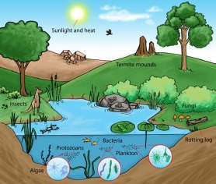
Lessons from Experience
Before a project, ask “what will change?”
Goal: Fundamental Process & Product Change
Concentrate on Framing the Right Questions.
Ask Big Questions
Plan Metrics - KPI
Strategy
Technology
Big Data Lessons
EcoSystem
Multidimensional Expertise is Essential
The Nature of Analytics has Changed
There are tradeoffs: e.g. Speed vs. Accuracy
Think Steams of Data
Do Not Ignore the Broader World: Data, Technology, Practices
Customer Focus: Make Heroes of Your Partners
RESEARCH – INCUBATION - PRODUCTION
Notes:
http://www.clker.com/cliparts/G/8/c/L/T/g/plant-growth-md.png

Slide 13
Lessons from Experience
Strategy
Technology
Big Data Lessons
EcoSystem
Before a project, ask “what will change?”
Goal: Fundamental Process & Product Change
Concentrate on Framing the Right Questions.
Ask Big Questions, but execute specific ones.
Plan Metrics - KPI
Think expansively about DATA: Organic and External
Build Trust, or it will be hard to get access to the data you need.
Start with small group that has clear understanding of impact, and good relationships with partners; as well as core technical capability. (6 => 350)
Organizational structure makes a HUGE difference.
There is low hanging fruit. (e.g. Process Transparency)
Be sensitive to organizational pitfalls ( Lucky Dog, Virtual Info Program).
Marketing is not a dirty word, (swift, …)
Governance is not a luxury.
You may want an “Analytics Review Board”
Notes:
http://www.clker.com/cliparts/G/8/c/L/T/g/plant-growth-md.png

Slide 14
Lessons from Experience
Strategy
Technology
Big Data Lessons
EcoSystem
Do Not Ignore the Broader World: Data, Technology, Practices
Customer Focus: Make Heroes of Your Partners
RESEARCH – INCUBATION - PRODUCTION
Take care in committing to technologies that are hard change
In the beginning, leverage a small team, as opposed to deleveraging a larger team.
Understand that there will be tension between existing organizations such as IT and BU.
In my experience, something like 1 in 5 Line Managers understand both the risks and rewards on being at the front. Watch out for and reward them, watch out for those that don’t understand either risks or rewards.
Notes:
http://www.clker.com/cliparts/G/8/c/L/T/g/plant-growth-md.png

Slide 15
Lessons from Experience
Multidimensional Expertise is Essential
The Nature of Analytics has Changed
There are tradeoffs: e.g. Speed vs. Accuracy
Think Steams of Data
Strategy
Technology
Big Data Lessons
EcoSystem
Lack of the right skills and skill mix is a recipe for trouble (6)
Technology generations are fairly short right now. (“One Size Fits None”)
Lots of Data ≠ Big Data (be careful of spending on elaborate infrastructures too early.)
Avoid becoming enamored with technology that is either too complex or too simple.
Avoid getting bound into technologies too soon.
Creation, Incubation and Production technologies do not have to be identical.
Notes:
http://www.clker.com/cliparts/G/8/c/L/T/g/plant-growth-md.png

Slide 16
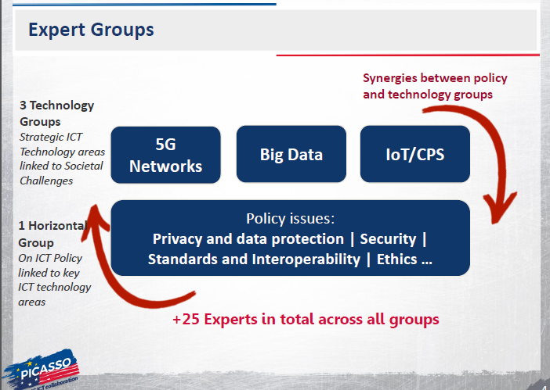
A Global Perspective PICASSO Project

Slide 17
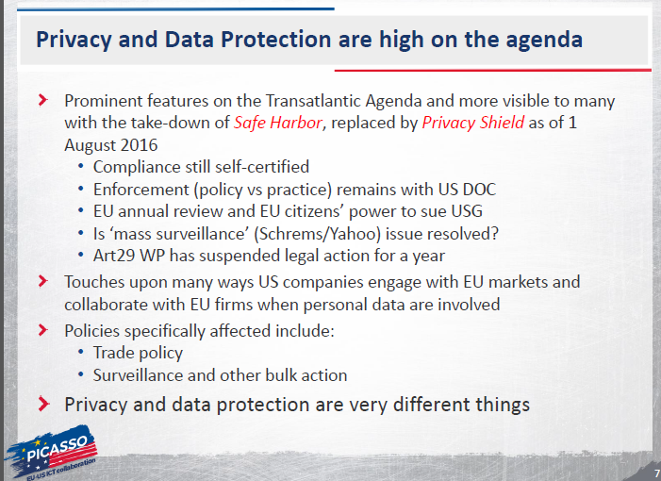
A Global Perspective PICASSO Project

Slide 18
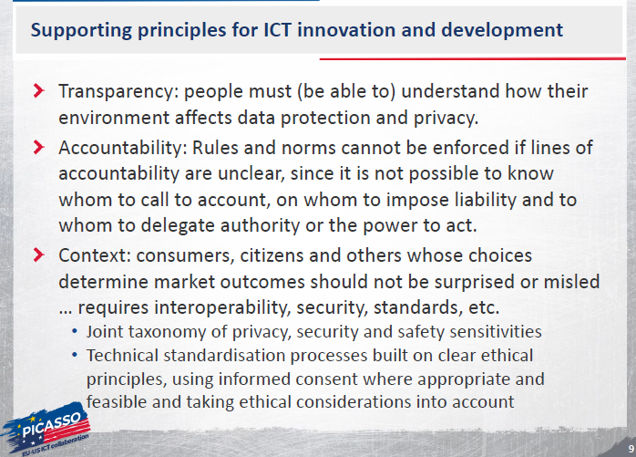
A Global Perspective PICASSO Project

Slide 19
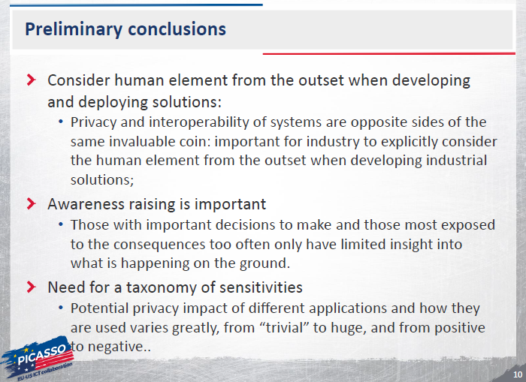
A Global Perspective PICASSO Project

Slide 20
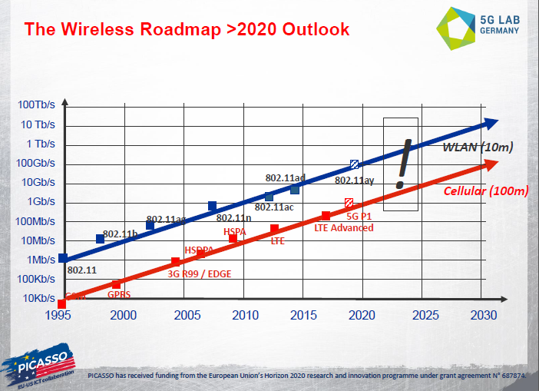
A Global Perspective PICASSO Project

Slide 21
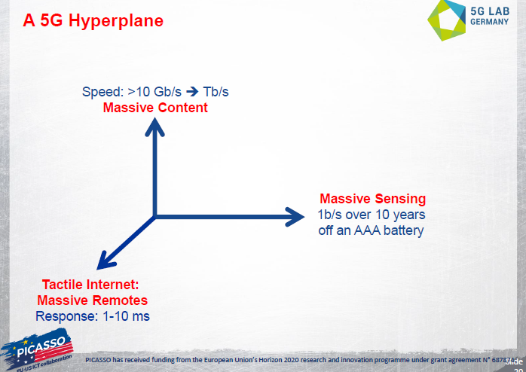
A Global Perspective PICASSO Project

Slide 22
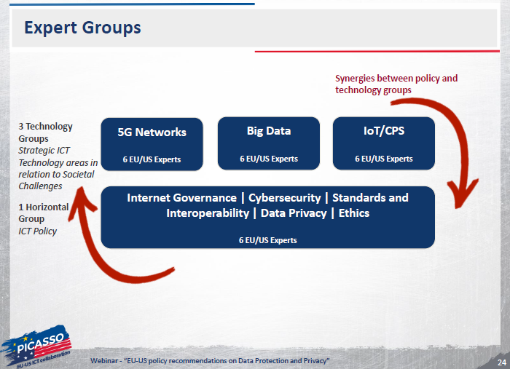
A Global Perspective PICASSO Project

Slide 23
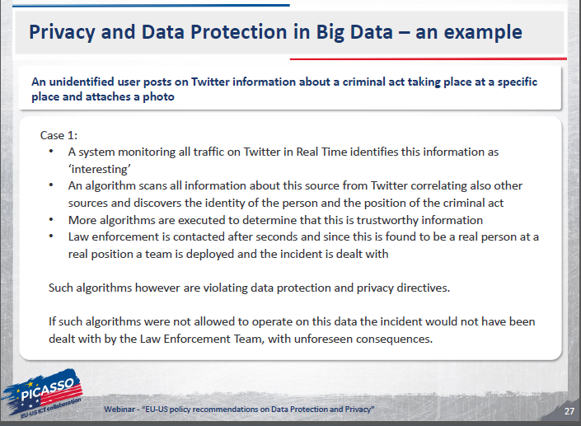
A Global Perspective PICASSO Project

Slide 24
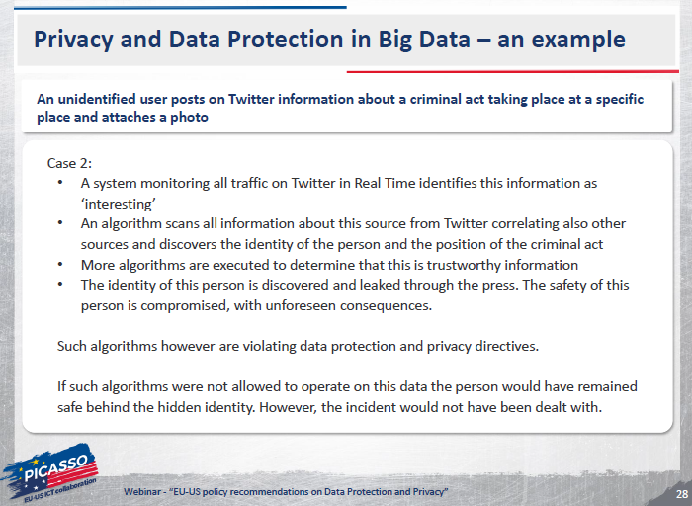
A Global Perspective PICASSO Project

Slide 25
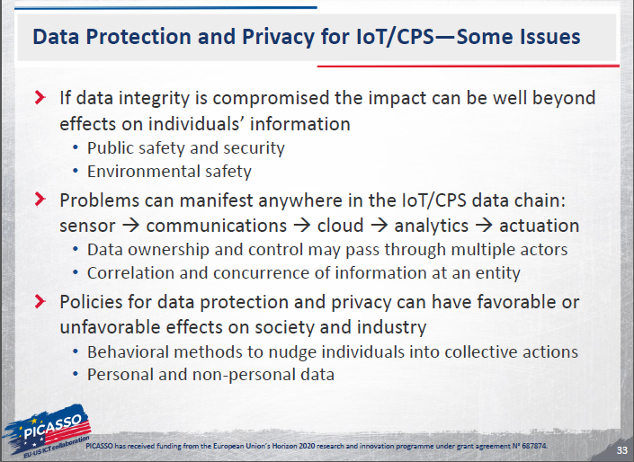
A Global Perspective PICASSO Project

Slide 26
More on Governance

Slide 27
Information Governance Disciplines Metadata
What is Metadata?
(First) it is not what is typically called Metadata in articles about NSA. That is Data.
Metadata is information about the structure and characteristics of data.
Hence it is one or more levels of abstraction above the data itself.
Examples:
Name (e.g. record, tuple, field name)
Location (e.g. disk, …)
(Perceived) Importance, Value to the Enterprise
Is it part of the supply chain, ordering process, or billing stream?
Is it required for regulatory activity
Is it essential for strategic decision making, or risk analysis
Is it essential for marketing to customers.
Quality
Perceived Risks, (e.g. proprietary, PII, trade secret, operational)
Structure and Relationships
Sources and Sinks of the Data and Information.
Replicents

Slide 28
Information Governance Disciplines Metadata
Some Metadata Best Practices (Soares):
Glossary of business definitions for key big data terms
Understand ongoing support for metadata within Hadoop (and other Big Data systems)
Tag sensitive big data within the business glossary
Import technical metadata from relevant big data stores
Link the relevant data sources to the terms in the business glossary
Leverage operational metadata to monitor the movement of big data (e.g. logs)
Maintain technical metadata to support data lineage and impact analysis
Gather metadata from unstructured documents to support enterprise search
Extend existing metadata roles to include big data (e.g. data dictionaries)
Establish, Document, and Automate where possible OAM&P

Slide 29
Meta Challenges – Use and Protection of Data
Then | Now
Significant systems containing sensitive data are not easily accessed. Complex semantics and poor integrity often exist, but impact is hidden because data is relatively closed. Integration, outside of joins, uncommon at scale. | Protection of SPI data a constant problem. Transparency of use, integrity of data a concern. Open data provides much more opportunity for interesting new apps from integration, and semantic confusion. Integration complex.
Security
Privacy
Integrity
Semantics
Integration

Slide 30
Meta Challenges – Making it all work
Then | Now
Significant systems containing sensitive data are not easily accessed. Complex semantics and poor integrity often exist, but impact is hidden because data is relatively closed. Integration, outside of joins, uncommon at scale. | Protection of SPI data a constant problem. Transparency of use, integrity of data a concern. Open data provides much more opportunity for interesting new apps from integration, and semantic confusion. Integration complex.
Organization
Training and Skills
Measurement
Risk, Conformance, Regulation
OA&M

Slide 31
Data Quality and Integrity
Then | Now
Much of the burden of quality and integrity lies in the fact that the ACID properties and input rules of transactional systems are strictly enforced. There is a very rich technical ecosystem that has been built around integrity and is made available in most mature data management systems. | In many systems, at the volume, velocity, latency, and complexity expected, the levels of correctness required of transactional systems are neither possible nor necessary. Analytic techniques must take these changes into account. Given the very diverse nature of potential data sources, and consequent reduction in control over the data, this becomes a very challenging problem.

Slide 32
Information Governance Disciplines Data Quality
Data Quality: Does the data mean what you think it does?
Review two Data Quality Tutorials (both available on web):
Data Quality and Data Cleaning: An Overview, Theodore Johnson, 2004, Given at Rutgers, www.cs.rutgers.edu/~muthu/dqted.ppt
Bellman: A Data Quality Browser, Tamraparni Dasu, Theodore Johnson, S. Muthukrishnan, Vladislav Shkapenyuk, Amit Marathe; dimacs.rutgers.edu/.../DataCleaning/slides/johnson.ppt

Slide 33
Big Data Quality
Dimension
Frequency
Variety
Traditional
Largely Batch
Structured
Big Data
Batch & RT - Streams
[ _ ,Semi,Un]Structured
Confidence Levels
Timing
Location of Analysis
ACID, Correct & Consistent
Prior to DW Load
Data Moves to Analysis
Good enough for analysis
Engines may move to data
Sunil Soares, Big Data Governance: An Emerging Imperative

Slide 34
Data Security, Data Loss Prevention
Then | Now
Much of the focus on data security was focused on the perimeter, hence on securing the inappropriate network access. Transactional data management systems enforced rules for access, and analytics were largely done on extracts, warehouses, and data marts. | The latest generation of data base and data stream tools are often not mature enough to have full featured security capability. In addition, the very low granularity of data allows weak data signals to be put together to create very strong results. Security technology is improved substantially, but so have attack techniques, and the shear volume/velocity of data puts stress on traditional techniques such as encryption and logging.

Slide 35
Short Hashing Overview
Hash Storage and Access
DeDuplication
Similarity
Counting
Checksums

Slide 36
Short Hashing Overview
Hash Storage and Access
N units of storage
Key/Entity
Hash Function

Slide 37
Hashing Overview Example of a Fast Hash Function – FNV-1a (non cryptographic)
hash = offset_basis
for each octet_of_data to be hashed
hash = hash xor octet_of_data
hash = hash * FNV_prime
return hash
Hash is an n bit unsigned integer, where n bits is the length of the hash
Multiplication is performed modulo 2^{n} , where n is the bit length of the hash
Xor is performed on the lower order 8 bits of the hash
http://www.isthe.com/chongo/tech/comp/fnv/index.html#FNV-1a

Slide 38
The FNV-1 hash parameters are as follows:
hash is an n bit unsigned integer, where n is the bit length of hash.
The multiplication is performed modulo 2n where n is the bit length of hash.
The xor is performed on the low order octet (8 bits) of hash.
The FNV_prime is dependent on n, the size of the hash:
32 bit FNV_prime = 224 + 28 + 0x93 = 16777619
64 bit FNV_prime = 240 + 28 + 0xb3 = 1099511628211
128 bit FNV_prime = 288 + 28 + 0x3b = 309485009821345068724781371
256 bit FNV_prime = 2168 + 28 + 0x63 = 374144419156711147060143317175368453031918731002211
512 bit FNV_prime = 2344 + 28 + 0x57 =
35835915874844867368919076489095108449946327955754392558399825615420669938882575
126094039892345713852759
Part of the magic of FNV is the selection of the FNV_prime for a given sized unsigned integer. Some primes do hash better than other primes for a given integer size.
The offset_basis for FNV-1 is dependent on n, the size of the hash:
32 bit offset_basis = 2166136261
64 bit offset_basis = 14695981039346656037
128 bit offset_basis = 144066263297769815596495629667062367629
256 bit offset_basis =
100029257958052580907070968620625704837092796014241193945225284501741471925557
512 bit offset_basis =
96593031294966694980094354007163104660904187456726378961083743294344626579945829
32197716438449813051892206539805784495328239340083876191928701583869517785
http://www.isthe.com/chongo/tech/comp/fnv/index.html#FNV-1a

Slide 39
Data Privacy and Anonymization
What is a decent definition of Data Privacy?

Slide 40
Data Privacy and Anonymization
What is a decent definition of Data Privacy?
Selective Revelation?
Confidentiality?
(Whatis) Data privacy, also called information privacy, is the aspect of information technology (IT) that deals with the ability an organization or individual has to determine what data in a computer system can be shared with third parties
(Wikipedia) Information privacy, or data privacy (or data protection), is the relationship between collection and dissemination of data, technology, the public expectation of privacy, and the legal and political issues surrounding them

Slide 41
Data Privacy and Anonymization
What are the strengths and weaknesses of the definitions on the previous slide?

Slide 42
Data Privacy and Anonymization
Some important terms:
PII: Personally Identifiable Information
Anonymization: The result of “processing personal data in order to irreversibly prevent identification” (Article 29 Data Protection Working Party)
Pseudonymization:
SPI: Sensitive Personal Information
Attacker: Third party, neither owner or user, accessing records intentionally or accidentally.

Slide 43
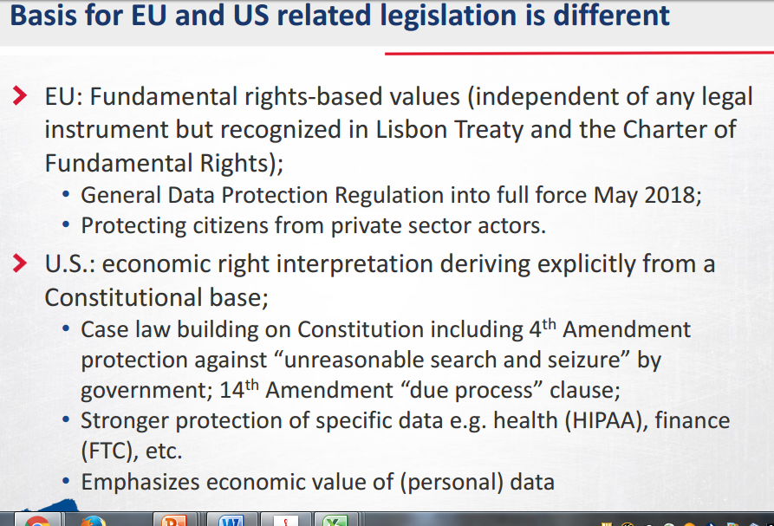


Slide 44
Data Privacy – China http://us.practicallaw.com/4-519-9017#a317009
CHINA: Ministry of Industry and Information Technology
In summary, the EU model of personal data protection law does not yet exist in the People's Republic of China. China has not enacted a single piece of legislation that specifically addresses the collection, storage, transmission and operation of personal information. China also has not entered into any treaty with the EU or any sovereignty similar to the EU-US safe harbour framework. However, the Civil Code and Tort Liability Law provide legal recourse for infringement of rights to privacy. There are also a few provisions in the PRC laws and regulations. These generally address the protection of personal information, typically regulating a specific industrial sector (for example, the telecommunication sector) or relate to certain information of a specific nature (for example, individual financial credit information, consumer information, population health information and medical records).

Slide 45
Data Privacy – India http://us.practicallaw.com/1-505-9607?q=Data+Protection+in+India#a588017
INDIA: Information Technology Act 2000 (IT Act).
Data controllers have the following main obligations to ensure data is processed properly:
Privacy policy. Every data controller that deals with sensitive personal data or information (SPDI) must have a privacy policy, and publish such policy on its website. The privacy policy must describe the type of information collected, the purpose of use of the information, to whom or how the information can be disclosed and the reasonable security practices and procedures followed to safeguard the information. A data controller must also appoint a grievance officer, whose name and contact details must be published on its website. The grievance officer must act on any complaint within 30 days of receiving the complaint.
Consent and notification. A data controller cannot collect SPDI unless it obtains the prior consent of the data subject. A business must also, before collecting the information, give the data subject the option not to provide such information. If this is the case, the business has the option to cease providing goods and services for which the information is sought. A business must also ensure that the data subject is aware:

Slide 46
Data Privacy
Privacy Policy
http://www.att.com/gen/privacy-policy?pid=2506
http://info.yahoo.com/privacy/us/yahoo/mail/ymail/details.html
Third Parties
http://www.jpmorgan.com/pages/cookies
Review Boards
Opt in/ Opt out
Balkanization
Standards
http://www.hhs.gov/ocr/privacy/hipaa/understanding/summary/index.html
Aggregation, Anonymization, Authentication.
Location – Real Time Privacy
http://www.google.com/intl/en/policies/privacy/

Slide 47
Anonymization
Data Set Anonymization Techniques:
Encryption
Substitution
Shuffling
Number and Data Variance
Nulling
Aggregation
Tools: Anonymous Data 1.11 by Urban Software and Anonimatron

Slide 48
Data Privacy and Anonymization Opinion 05/2014 on Anonymization Techniques, Article 29 Data Protection Working Party
Working Definition:
Anonymization: The result of “processing personal data in order to irreversibly prevent identification” (Article 29 Data Protection Working Party)
Underlying rationale: “Outcome of anonymization as a technique applied to personal data should be, in the current state of technology, as permanent as erasure.”
3 Criteria for robustness of anonymization techniques:
Is it still possible to single out an individual?
Is it still possible to link records relating to an individual?
Can information be inferred concerning an individual?

Slide 49
Data Privacy and Anonymization Opinion 05/2014 on Anonymization Techniques, Article 29 Data Protection Working Party
Approaches to Anonymization:
Randomization
Addition of noise
Permutation
Differential Privacy
Generalization
Aggregation and K-Anonymity
L-Diversity
T-Closeness
Pseudonymization

Slide 50
Data Privacy and Anonymization Opinion 05/2014 on Anonymization Techniques, Article 29 Data Protection Working Party
Approaches to Anonymization:
Randomization
Addition of noise: “modifying attributes in the dataset such that they are less accurate whilst retaining the overall distributiion”
Permutation
Differential Privacy
Generalization
Aggregation and K-Anonymity
L-Diversity
T-Closeness
Pseudonymization

Slide 51
Data Privacy and Anonymization Opinion 05/2014 on Anonymization Techniques, Article 29 Data Protection Working Party
Approaches to Anonymization:
Randomization
Addition of noise: “modifying attributes in the dataset such that they are less accurate whilst retaining the overall distributiion”
Guarantees:
Singling out: Still possible to single out records of individuals (perhaps non-identifiable) though records are less reliable.
Linkability: Still possible to link records of an individual, though data less reliable. Wrong data could expose individual to more risk than correct one.
Inference: May be possible, though lower success rate, and more false positives/negatives possible.

Slide 52
Data Privacy and Anonymization Opinion 05/2014 on Anonymization Techniques, Article 29 Data Protection Working Party
Approaches to Anonymization:
Randomization
Addition of noise: “modifying attributes in the dataset such that they are less accurate whilst retaining the overall distributiion”
Common Mistakes:
Adding inconsistent noise, e.g. out of scale, could allow an attacker to filter out noise, and possibly regenerate original data.
Sparse Datasets: may be possible to link noisy data entries with an external data source.
Assuming noise addition is enough: noise addition is generally a complementary measure, making it harder for an attacker to retrieve personal data.

Slide 53
Data Privacy and Anonymization Opinion 05/2014 on Anonymization Techniques, Article 29 Data Protection Working Party
Approaches to Anonymization:
Randomization
Addition of noise: “modifying attributes in the dataset such that they are less accurate whilst retaining the overall distributiion”
Failures:
Netflix:
100 Million ratings, from 1 – 5, on 18,000 movies, and by 500,000 users
All customer identifying info removed except ratings and dates. Noise added to ratings
Result: 99% of all users uniquely identified using 8 ratings and dates with 14 day errors as selection criteria.

Slide 54
Data Privacy and Anonymization Opinion 05/2014 on Anonymization Techniques, Article 29 Data Protection Working Party
Approaches to Anonymization:
Randomization
Addition of noise
Permutation: Shuffling values of attributes in a table so that some of them are artificially linked to different data subjects. Retains exact distribution of attribute values.
Differential Privacy
Generalization
Aggregation and K-Anonymity
L-Diversity
T-Closeness
Pseudonymization

Slide 55
Data Privacy and Anonymization Opinion 05/2014 on Anonymization Techniques, Article 29 Data Protection Working Party
Approaches to Anonymization:
Randomization
Permutation: Shuffling values of attributes in a table so that some of them are artificially linked to different data subjects. Retains exact distribution of attribute values.
Guarantees:
Singling out: As with noise addition, still possible to single out records of individuals (perhaps non-identifiable) though records are less reliable.
Linkability: If permutation impacts attributes and quasi-identifiers, it may prevent “correct” linking of attributes, both internally and externally, but still allow “incorrect” linkability.
Inference: Only probable inference remains possible.

Slide 56
Data Privacy and Anonymization Opinion 05/2014 on Anonymization Techniques, Article 29 Data Protection Working Party
Approaches to Anonymization:
Randomization
Permutation: Shuffling values of attributes in a table so that some of them are artificially linked to different data subjects. Retains exact distribution of attribute values.
Common Mistakes:
Selecting the wrong attribute to permute: For example, selecting a non-sensitive or non-risky attribute will not result in significant protection.
Permuting attributes randomly: If two attributes are storngly correlated, then permuting the attributes randomly will not provide strong guarantees. See Following slide.
Assuming permutation is enough: permutation is generally a complementary measure, making it harder for an attacker to retrieve personal data.

Slide 57
Data Privacy and Anonymization Opinion 05/2014 on Anonymization Techniques, Article 29 Data Protection Working Party
Year Gender Job Income (permuted)
1957 M Engineer 70k
1957 M CEO 5k
1957 M Unemployed 43k
1964 M Engineer 100k
1964 M Manager 45k
Table 1. An ineffective example of anonymisation by permutation of correlated attributes

Slide 58
Data Privacy and Anonymization Opinion 05/2014 on Anonymization Techniques, Article 29 Data Protection Working Party
Approaches to Anonymization:
Randomization
Permutation: Shuffling values of attributes in a table so that some of them are artificially linked to different data subjects. Retains exact distribution of attribute values.
Failures:
In above table:
E.g. Inspection likely shows that, based on income and year of birth, CEO likely born in 1957 and has highest income while unemployed was born in 1964 and has lowest income.

Slide 59
Data Privacy and Anonymization Opinion 05/2014 on Anonymization Techniques, Article 29 Data Protection Working Party
Approaches to Anonymization:
Randomization
Addition of noise: “modifying attributes in the dataset such that they are less accurate whilst retaining the overall distributiion”
Permutation
Differential Privacy: typically generated through a subset of queries for a particular third party, while original data remains unchanged.
Generalization
Aggregation and K-Anonymity
L-Diversity
T-Closeness
Pseudonymization

Slide 60
Data Privacy and Anonymization Opinion 05/2014 on Anonymization Techniques, Article 29 Data Protection Working Party
Approaches to Anonymization:
Differential Privacy: typically generated through a subset of queries for a particular third party, while original data remains unchanged.
Basic Idea:
Given a statistic, A, aggregated over some dataset.
Protect against an attacker querying two sets, R and S, which may differ by only 1 record, and a test set Q.
A is called epsilon-differentially private if and only if:
|log( (P (A(R)) in Q)/P(A(S) in Q)) | <= epsilon
(i.e. it is very difficult to tell whether probability of something being in R or S is different)
Basic Idea: “Learn as much as possible about a group while revealing as little as possible about and individual in it” Andy Greenberg, Wired 6/2016.

Slide 61
Data Privacy and Anonymization Opinion 05/2014 on Anonymization Techniques, Article 29 Data Protection Working Party
Approaches to Anonymization:
Differential Privacy: typically generated through a subset of queries for a particular third party, while original data remains unchanged.
Guarantees:
Singling out: If only statistics are output and rules applied to the set are well chosen, it should not be possible to use the answers to single out an individual
Linkability: Using multiple requests, it might be possible to link the entries relating to a specific individual between two answers.
Inference: Remains possible to infer information about individuals or groups by using multiple requests.

Slide 62
Data Privacy and Anonymization Opinion 05/2014 on Anonymization Techniques, Article 29 Data Protection Working Party
Approaches to Anonymization:
Randomization
Differential Privacy: typically generated through a subset of queries for a particular third party, while original data remains unchanged.
Common Mistakes:
Not injecting enough noise: It remains a difficult problem to generate the proper amount of noise to add to the true answers, to both protect individuals and preserve usefulness of released responses.
Treating each query independently

Slide 63
Data Privacy and Anonymization Opinion 05/2014 on Anonymization Techniques, Article 29 Data Protection Working Party
Approaches to Anonymization:
Randomization
Addition of noise
Permutation
Differential Privacy
Generalization
Aggregation and K-Anonymity: Techniques for preventing an individual from being singled out by grouping him/her with at least K other individuals. Attribute values must be generalized such that each individual shares the same value (or range of values).
L-Diversity
T-Closeness
Pseudonymization

Slide 64
Data Privacy and Anonymization Opinion 05/2014 on Anonymization Techniques, Article 29 Data Protection Working Party
Approaches to Anonymization:
Generalization:
Aggregation and K-Anonymity: Techniques for preventing an individual from being singled out by grouping him/her with at least K other individuals. Attribute values must be generalized such that each individual shares the same value (or range of values).
Guarantees:
Singling out: since the same attributes are shared by K individuals, it should no longer be possible to single out an individual within the group of K.
Linkability: Limited, but remains possible to link records by groups of K individuals. Then probability that two records correspond to the same pseudo-identifiers is 1/K.
Inference: K-anonymity does not prevent inference attacks. If it is known what group an individual belongs to, it is trivial to retrieve attributes.

Slide 65
Data Privacy and Anonymization Opinion 05/2014 on Anonymization Techniques, Article 29 Data Protection Working Party
Approaches to Anonymization:
Generalization:
Aggregation and K-Anonymity: Techniques for preventing an individual from being singled out by grouping him/her with at least K other individuals. Attribute values must be generalized such that each individual shares the same value (or range of values).
Common Mistakes:
Missing some quasi-identifiers: See following table
Small value of K: Increases to value of an inference attack.
Not grouping individuals with the same weight: Crucial that no single individual represent too important a fraction of the entries in a cluster.

Slide 66
Data Privacy and Anonymization Opinion 05/2014 on Anonymization Techniques, Article 29 Data Protection Working Party
Year Gender ZIP Diagnosis
1957 M 750* Heart attack
1957 M 750* Cholesterol
1957 M 750* Cholesterol
1964 M 750* Heart attack
1964 M 750* Heart attack
Table 2. An example of poorly engineered k-anonymisation

Slide 67
Data Privacy and Anonymization Opinion 05/2014 on Anonymization Techniques, Article 29 Data Protection Working Party
Approaches to Anonymization:
Generalization:
Aggregation and K-Anonymity: Techniques for preventing an individual from being singled out by grouping him/her with at least K other individuals. Attribute values must be generalized such that each individual shares the same value (or range of values).
Failures:
Inference attacks: In above table, if an attacker knows a specific individual is in a table, and was born in 1964, then he also knows the individual had a heart attack. In addition, if in France, 750* = Paris, so individual resides in Paris.

Slide 68
Data Privacy and Anonymization Opinion 05/2014 on Anonymization Techniques, Article 29 Data Protection Working Party
Approaches to Anonymization:
Randomization
Addition of noise
Permutation
Differential Privacy
Generalization
Aggregation and K-Anonymity: Techniques for preventing an individual from being singled out by grouping him/her with at least K other individuals. Attribute values must be generalized such that each individual shares the same value (or range of values).
L-Diversity: extends K-anonymity to ensure that inference attacks are no longer possible by ensuring that in each equivalence class every attribute has at least l different values. Still subject to probabilistic inference attacks.
T-Closeness: attempts to create equivalence classes that resemble the initial distribution of the attributes in a table.
Pseudonymization

Slide 69
Data Privacy and Anonymization Opinion 05/2014 on Anonymization Techniques, Article 29 Data Protection Working Party
Approaches to Anonymization:
Generalization:
L-Diversity: extends K-anonymity to ensure that inference attacks are no longer possible by ensuring that in each equivalence class every attribute has at least l different values. Still subject to probabilistic inference attacks.
T-Closeness: attempts to create equivalence classes that resemble the initial distribution of the attributes in a table.
Guarantees:
Singling out: as with k-anonymity, l-diversity and t-closeness can ensure that records relating to an individual cannot be singled out.
Linkability: Limited, as with K-anonymity. The probability that two records correspond to the same pseudo-identifiers is 1/N (where N is the number of data subjects in the database).
Inference: It is no longer possible to set up an inference attack against an l-diverse or t-close database with 100% confidence.

Slide 70
Data Privacy and Anonymization Opinion 05/2014 on Anonymization Techniques, Article 29 Data Protection Working Party
Approaches to Anonymization:
Generalization:
L-Diversity: extends K-anonymity to ensure that inference attacks are no longer possible by ensuring that in each equivalence class every attribute has at least l different values. Still subject to probabilistic inference attacks.
T-Closeness: attempts to create equivalence classes that resemble the initial distribution of the attributes in a table.
Common Mistakes:
Protecting sensitive attributes by mixing them with other sensitive attributes. Distribution of values of an attribute should mirror distributions of values in the total population, or be uniform.

Slide 71
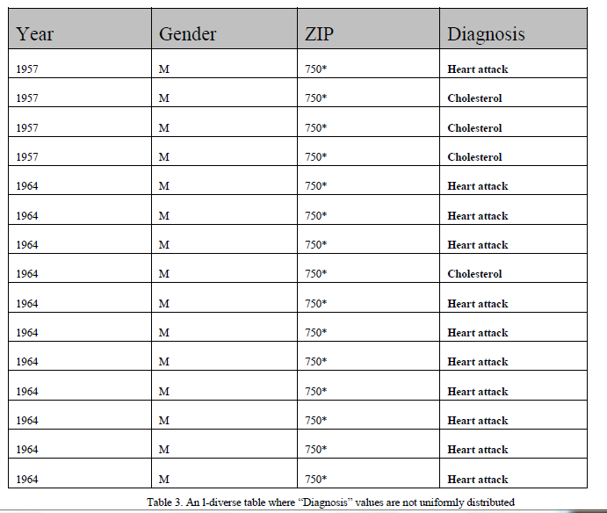
Data Privacy and Anonymization Opinion 05/2014 on Anonymization Techniques, Article 29 Data Protection Working Party

Slide 72
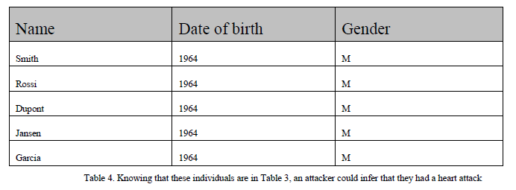
Data Privacy and Anonymization Opinion 05/2014 on Anonymization Techniques, Article 29 Data Protection Working Party

Slide 73
Data Privacy and Anonymization Opinion 05/2014 on Anonymization Techniques, Article 29 Data Protection Working Party
Approaches to Anonymization:
Generalization:
L-Diversity: extends K-anonymity to ensure that inference attacks are no longer possible by ensuring that in each equivalence class every attribute has at least l different values. Still subject to probabilistic inference attacks.
T-Closeness: attempts to create equivalence classes that resemble the initial distribution of the attributes in a table.
Failures:
See above tables. L-diversity is true with respect to “diagnosis” but knowing that an individual born in 1964 is in this table, it is still possible to conclude, with very high confidence, that he/she had a heart attack.

Slide 74
Data Privacy and Anonymization Opinion 05/2014 on Anonymization Techniques, Article 29 Data Protection Working Party
Approaches to Anonymization:
Randomization
Addition of noise
Permutation
Differential Privacy
Generalization
Aggregation and K-Anonymity: Techniques for preventing an individual from being singled out by grouping him/her with at least K other individuals. Attribute values must be generalized such that each individual shares the same value (or range of values).
L-Diversity: extends K-anonymity to ensure that inference attacks are no longer possible by ensuring that in each equivalence class every attribute has at least l different values. Still subject to probabilistic inference attacks.
T-Closeness: attempts to create equivalence classes that resemble the initial distribution of the attributes in a table.
Pseudonymization: replacing one attribute in a record, typically a unique attribute, with another attribute. When used alone will typically not result in an anonymous dataset.

Slide 75
Data Privacy and Anonymization Opinion 05/2014 on Anonymization Techniques, Article 29 Data Protection Working Party
Approaches to Anonymization:
Pseudonymization: replacing one attribute in a record, typically a unique attribute, with another attribute. When used alone will typically not result in an anonymous dataset.
Techniques:
Encryption with secret key: Key holder can easily re-identify the data subject using decryption. Assuming that state of the art encryption is used, decryption will require knowledge of the key.
Hash function: function returning a fixed size output from any size input, and cannot be reversed. Subject to brute force attacks, and pre-computed tables can allow bulk reversal of the hashes.
Salted hash function: random value, “salt value” is added to the attribute being hashed.
Keyed hash function with stored key: a hash function which uses a secret key as additional input, reducing the possibilities and therefore value of brute force attack
Deterministic encryption or keyed-hash function with deletion of the key: roughly equivalent to replacing attribute value by a random number and deleting the correspondence table.
Tokenization: often used in financial data to replace card ID numbers by values that have reduced usefulness to an attacker. Typically based on one-way encryption or assignment, through an index function, of a sequence number or randomly generated number not generated from the original data.

Slide 76
Data Privacy and Anonymization Opinion 05/2014 on Anonymization Techniques, Article 29 Data Protection Working Party
Approaches to Anonymization:
Pseudonymization: replacing one attribute in a record, typically a unique attribute, with another attribute. When used alone will typically not result in an anonymous dataset.
Guarantees:
Singling out: still possible to single out individuals as the individual is still identified by a unique attribute.
Linkability: Still easy between records using the same pseudonymized attribute to refer to the same individual. Even if pseudonymized values are varied for the same individual, other attributes can be used.
Inference: possible within the dataset or across datasets using the same pseudonymized attribute for an individual.

Slide 77
Data Privacy and Anonymization Opinion 05/2014 on Anonymization Techniques, Article 29 Data Protection Working Party
Approaches to Anonymization:
Pseudonymization: replacing one attribute in a record, typically a unique attribute, with another attribute. When used alone will typically not result in an anonymous dataset.
Common Mistakes:
Believing that a pseudonymized dataset is anonymized.
Common mistakes when using pseudonymization to reduce linkability:
Using the same key in different databases
Using different keys (“rotating keys”) for different individuals
Keeping a secret key

Slide 78
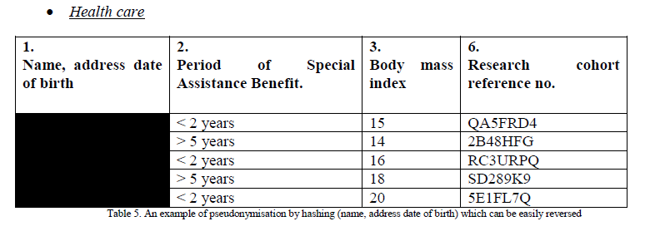
Data Privacy and Anonymization Opinion 05/2014 on Anonymization Techniques, Article 29 Data Protection Working Party

Slide 79
Data Privacy and Anonymization Opinion 05/2014 on Anonymization Techniques, Article 29 Data Protection Working Party
Approaches to Anonymization:
Pseudonymization: replacing one attribute in a record, typically a unique attribute, with another attribute. When used alone will typically not result in an anonymous dataset.
Shortcomings:
Healthcare: See previous slide
Social Networks: Use of graph edges
Location Data: MIT study of 15 months of spatial-temporal mobility coordinates of 1.5 million people on a 100 KM radius territory – 95% of the population could be singled out with 4 locations. 2 points were enough for >50%

Slide 80
Data Privacy and Anonymization Opinion 05/2014 on Anonymization Techniques, Article 29 Data Protection Working Party
Recommendations:
Consider inherent limitations of each technique when using it.
Consider the trade-off between usability and risk
Each approach has limitations and strengths. Some risks can be reduced by careful engineering. See following slide for overview of strengths and weaknesses.
Optimal solution should be decided on a case by case basis, and as with security, with regard to the class of attackers being defended against.
Consider laws, regulations, and compliance where required.

Slide 81
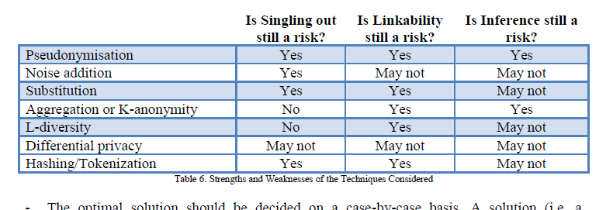
Data Privacy and Anonymization Opinion 05/2014 on Anonymization Techniques, Article 29 Data Protection Working Party

Slide 82
Data Privacy and Anonymization Opinion 05/2014 on Anonymization Techniques, Article 29 Data Protection Working Party
Good Practices:
Do not rely on “Release and Forget”
As part of residual risks, take into account the identification potential of the non-anonymized portion of the dataset, plus correlation between attributes (e.g. location and wealth level data, or location and time of day/day of week data)
Context:
Purposes to be achieved by anonymized dataset
Attackers, taking into account appeal of the dataset.

Slide 83
K-Anonymization
A popular generalization technique
http://cscdb.nku.edu/pais08/papers/p-pais07.pdf
Latanya Sweeney of CMU: ZipCode + Gender + Age identifies 87% of US residents.
De Montjoye et al. from MIT: showed that 4 spatio-temporal points, approximate places and times, are enough to uniquely identify 95% of 1.5 million people in a mobility database.*
Issue with K-anonymization are:
How to set K
Algorithms for executing anonymization are often exponential
* Montjoye, Yves-Alexandre; César A. Hidalgo; Michel Verleysen; Vincent D. Blondel (March 25, 2013). "Unique in the Crowd: The privacy bounds of human mobility". Nature srep. doi:10.1038/srep01376. Retrieved 12 April 2013.

Slide 84
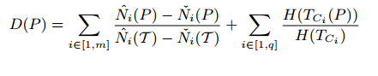
K-Anonymization – Basic Concepts
Information Loss:
T = A set of records
m numeric quasi identifiers – N1, … Nm
q categorical quasi identifiers – C1, …. Cq
P = {p1, … pp} a partition of T, pi disjoint
Each Ci has a taxonomy tree, Tci, to generalize its values. Height of tree is H
N is min, max, mean within P.
Diversity of P =
To anonymize means to generalize the members of each partition member P to the same value, with minimal information loss.

Slide 85
K-Anonymization – Basic Concepts
Cluster Based Approaches
Similar to K-Means, with some changes:
One Pass
Sort by quasi-identifiers
Randomly select K members as a starting point.
For each point:
Select the closest cluster using sum of the distance to each member of the cluster (hence reducing large clusters).
Add new point to selected cluster
Update the centroid for the selected cluster
Adjustment:
(next slide)

Slide 86
K-Anonymization – Basic Concepts
Cluster Based Approaches
Adjustment (eliminate clusters smaller than K):
For each cluster with more than K items, sort items by distance to centroid.
Remove furthest items until size equals K
From the set of removed items from each cluster, add that item to the nearest cluster with size less than K.

Slide 87
Anonymization
Network Anonymization Techniques:
Vertex Existance – Does individual appear in network
Vertex Properties – e.g. degree
Sensitive Vertex Labels
Link relationships
Link weight
Sensitive edge labels
Graph Metrics – betweenness, closeness, centrality, path length, reachability, …

Slide 88
Anonymization
Network Utility :
General Graph Properties
Aggregate Network Queries
Methods of anonymization
Clustering Based
Graph Modification Based

Slide 89
Anonymization
Clustering Based Anonymization
Vertex Clustering
Vertex Refinement Queries
Subgraph Queries
Hub Fingerprint Queries
Edge Clustering
Remove sensitive edges
Collapse vertices across an edge
Vertex + Edge Clustering
Graph Modification anonymization
Degree Attacks – Graph K-anonymization
Randomized edge construction
Randomized Spectrum Preserving – eigenvalues of the adjacency matrix.
Randomized Weight Perturbation Methods.

Slide 90
Security Network vs. Data
Network Risks:
Availability of all Resources
Protection from Malware
Infrastructure Damage
Data Risks:
Data Loss Prevention
Data Theft
Data Integrity

Slide 91
Security The Challenge
Axiom 1: Very High Levels of Data Security Can be Achieved, but at a Significant Cost.
Cost of Security Mechanisms and Processes
Lost Opportunity Costs
Axiom 2: Very High Levels of Data Availability Can be Achieved, but at a Significant Risk.
Data Loss
Data Theft
Data Corruption
Resulting in Loss of Revenue; high replacement cost and time; adverse publicity resulting in loss of customers.
So: “What to do?”
Note: “Data” described here could be software, trade secrets, proprietary information, or database contents.

Slide 92
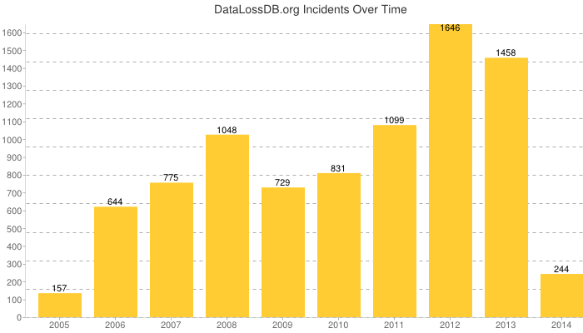
Data Security Situation
datalossdb.org/statistics

Slide 93
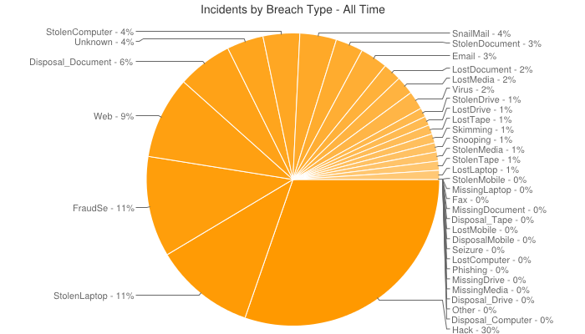
Data Security Situation
datalossdb.org/statistics

Slide 94
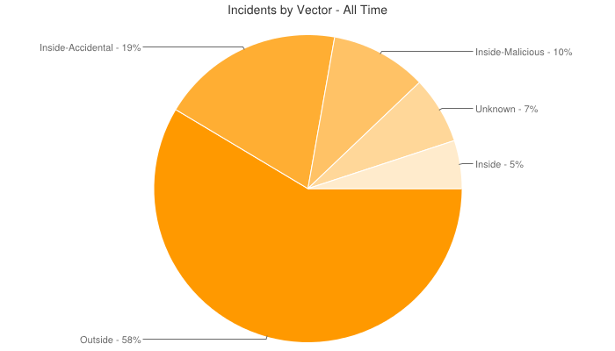
Data Security Situation
datalossdb.org/statistics

Slide 95
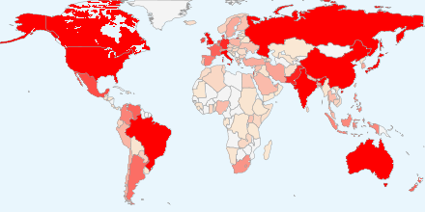
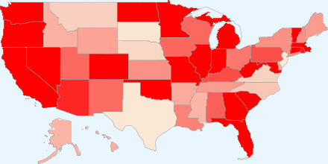
Data Security Situation
datalossdb.org/statistics

Slide 96
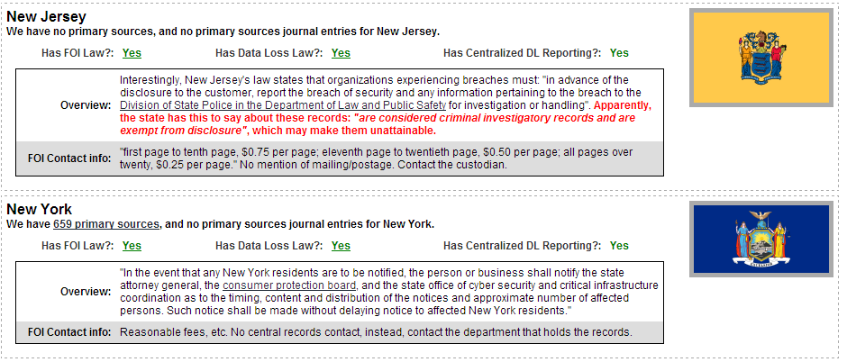
Data Loss Laws
datalossdb.org/statistics

Slide 97
Verizon Recommended Controls Point of Sale Intrusions http://www.verizonenterprise.com/DBIR/2014/ p.19
For all companies:
Restrict remote access
Enforce password policies
“S” is for “Sale”, not “Social”
Deploy Anti-Virus
For large/multi-store companies:
Debunk the flat network theory
Look for suspicious network activity
Use two-factor authentication

Slide 98
Verizon Recommended Controls Web App Attacks http://www.verizonenterprise.com/DBIR/2014/ p.22
Single Password Fail
Rethink CMS
Validate Inputs
Enforce lockout policies
Monitor outbound connections

Slide 99
Verizon Recommended Controls Insider and Privilege Misuse http://www.verizonenterprise.com/DBIR/2014/ p.26
Know your data and who has access to it
Review user accounts
Watch for data exfiltration
Publish audit results

Slide 100
Verizon Recommended Controls Physical Access and Theft http://www.verizonenterprise.com/DBIR/2014/ p.28
Encrypt devices
Keep it with you
Back it up
Lock it down
Use unappealing technology

Slide 101
Verizon Recommended Controls Miscellaneous http://www.verizonenterprise.com/DBIR/2014/ p.31
Use DLP (Data loss prevention) systems
Check out the pub (lishing)
Nail the snail mail fail whale
IT don’t make trash

Slide 102
Data Loss Prevention - Technologies
Data Erasure – Data Retention Enforcement
Cryptographic Protection
Encryption / Authentication
Data At Rest
Data in Flight
Network Level Protection
Firewalls, Network Zones
Network Admission Controls
Trusted Computing
Intrusion Detection / Prevention
Secure Auditing
Anti Malware Detection / Elimination
Transaction / User Monitoring – Forensics/Fraud
Data Leakage Prevention:
Data Profiling – Discovery and Classification
Policy Enforcement
Data Masking

Slide 103
Data Security Basics - Transformation
Data Transformation:
Compression / Differencing
http://www.data-compression.com/lempelziv.html
Encryption

Slide 104
Data Encryption
PGP, GPG, …
Data Encryption Standard, Triple DES
Advanced Encryption Standard
https://engineering.purdue.edu/kak/compsec/NewLectures/Lecture8.pdf

Slide 105
AES Requirements
Security
Resistance to cryptanalysis (breaking code),
Mathematically sound,
Randomness of output
Cost
Computational efficiency (speed)
Memory requirements
Algorithm / Implementation Characteristics
Flexibility,
Encrypt/decrypt,
Keying
Hardware and software suitability,
C, Java Implementations
Algorithmic simplicity
Intended for unclassified use

Slide 106
Data Security Basics - AAA
Authentication
Authorization
Accounting

Slide 107
Data Security Basics - Authentication
Something you know
Passwords
Address
Question/Answer
Something you are
Voice Pattern
Physical Pattern – eye, fingerprint,
Something you have
RSA SecureID
Magnetic Strip

Slide 108
Data Security Basics - Authorization
Level of Granularity
Database
Record/Object
Field
Rule Based
Time of Day
Position Based
Hardware Based (e.g. MAC Codes)
Individual – See Authentication

Slide 109
Data Security Basics - Accounting
Logs for all database activity including:
Accesses
Input/Output
ACD
Generally, the is no transitivity to Logs
Log analysis tools are fairly common
RT Log Analysis somewhat less common

Slide 110
Data Security Key Issues
Availability
Confidentiality
Integrity
Privacy

Slide 111
Data Security Availability
Minimize the damage from attacks that make key data unavailable to authorized users.
Data must be restricted to authorized users
Log facilities must be able to track:
Who has access
What has been accessed
Where has data been moved

Slide 112
Data Security Confidentiality
Minimize damage from unauthorized data disclosure
Control of access to confidential data
Database protected from external or internal breaches
Reporting on who, what, when.
Alerting and alarming on potential breaches
Extra levels of security for sensitive data, e.g. mission critical, legal, trade secret.

Slide 113
Data Security Integrity
Minimize deliberate corruption of data entities including:
Damage from use of low-integrity data
Damage from corrupted entities (e.g. programs) misusing privileges
Verify that input data is correct and verifiable
Ensure data is following existing workflow rules
Log all data changes, what and who.
Ensure compliance with all corporate rules, regulations, and laws.

Slide 114
Data Security Privacy
Certain Information should only be used for specific purposes, under specific conditions / contexts with specific obligations
PII data should be tagged and treated as such
All requests are by users authorized for that request
Outbound data is going to expected recipient

Slide 115
Experience
Many of the data security options assume a DBMS with a major role.
This is the case of standard, operational systems
It is often not the case for analytical systems, e.g. materialized views, data marts, extracts.
It is often not the case for Big Data systems which are less mature.
Access – Authentication/Authorization become more important

Slide 116
Experience (2)
The balance between security and usability is never solved.
Remote access
Multiple domains – e.g. copy or outside access
Retention vs Longitudinal Analysis
Aggregation vs Anonymity

Slide 117
Data Security
Standards: PCI, HIPAA, FISMA
https://www.pcisecuritystandards.org/security_standards/index.php
http://www.hhs.gov/ocr/privacy/hipaa/administrative/securityrule/security101.pdf
Encryption
Logs / Audits
Cloud

Slide 118
Information Governance Disciplines Metadata
Some Metadata Best Practices (Soares):
Glossary of business definitions for key big data terms
Understand ongoing support for metadata within Hadoop (and other Big Data systems)
Tag sensitive big data within the business glossary
Import technical metadata from relevant big data stores
Link the relevant data sources to the terms in the business glossary
Leverage operational metadata to monitor the movement of big data (e.g. logs)
Maintain technical metadata to support data lineage and impact analysis
Gather metadata from unstructured documents to support enterprise search
Extend existing metadata roles to include big data (e.g. data dictionaries)
Establish, Document, and Automate where possible OAM&P

Slide 119
A More Complete Picture
Data
Management
Visualization
Applications
Data Analysis
Incubation
Data Governance – Policy, Process
Data Security
Sandbox
Privacy
Integrity
OA&M
Semantics
Software
Framing Questions
Sustainability
Distribution & Ownership
of Results

